Slide 1





Partition Pruning
&
Predicate Pushdown
Interview Question

Slide 2
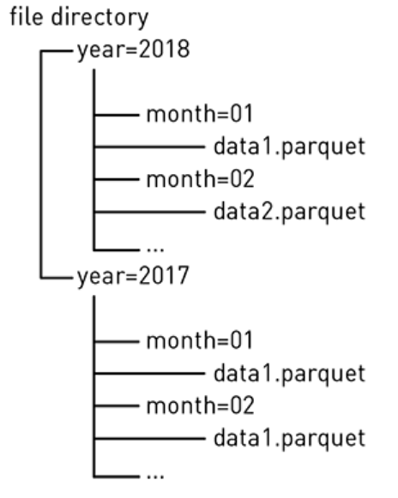
Partition Pruning and Predicate Pushdown
Partitioning
Spark table partitioning optimizes reads by storing files in a hierarchy of directories based on partitioning columns.
For example, a directory structure could be organized by location, such as state/city, or by date, such as year/month, shown below.

Slide 3
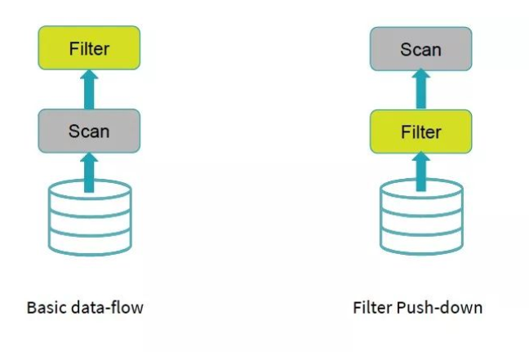
Partition Pruning and Predicate Pushdown
Partition pruning is a performance optimization that limits the number of files and partitions that Spark reads when querying.
After partitioning the data, queries that match certain partition filter criteria improve performance by allowing Spark to only read a subset of the directories and files.
When partition filters are present, the catalyst optimizer pushes down the partition filters.
The scan reads only the directories that match the partition filters, thus reducing disk I/O.

Slide 4
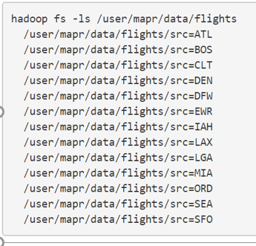
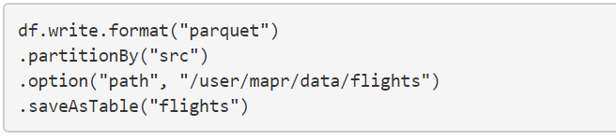

Partition Pruning and Predicate Pushdown

Slide 5
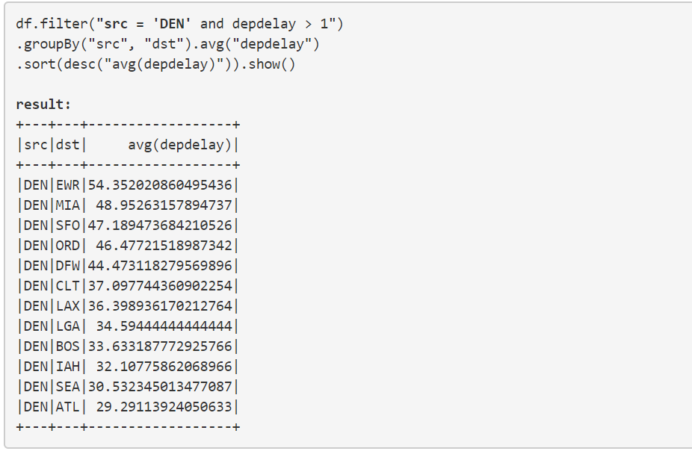
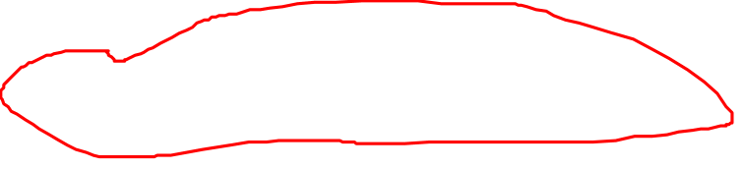
Partition Pruning and Predicate Pushdown

Slide 6
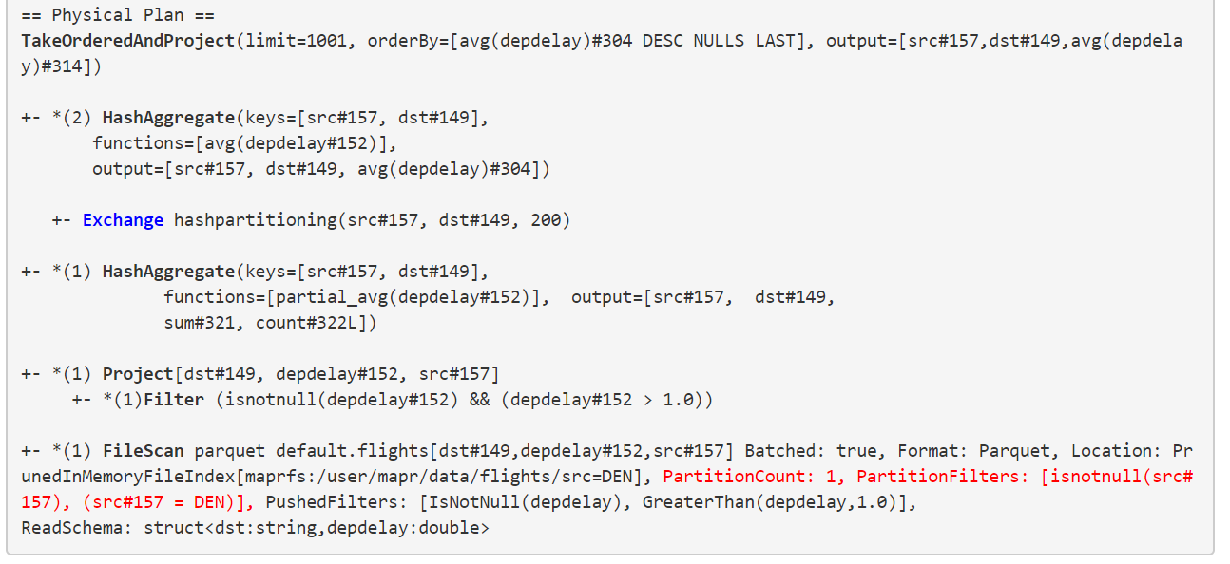
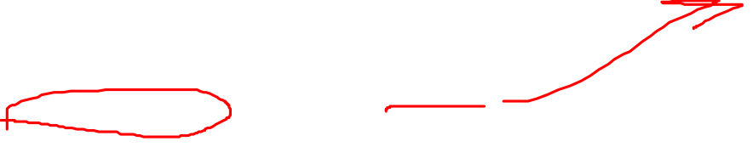
Partition Pruning and Predicate Pushdown

Slide 7
Partition Pruning and Predicate Pushdown
Conclusion :
The partition columns should be used frequently in queries for filtering
The Partition should have a small range of values with enough corresponding data to distribute the files in the directories.
Need to avoid too many small files, which make scans less efficient with excessive parallelism.
At the same time avoid having too few large files, which can hurt parallelism.

Slide 8
Partition Pruning and Predicate Pushdown
Thanks and do subscribe to my channel

